Slide 1
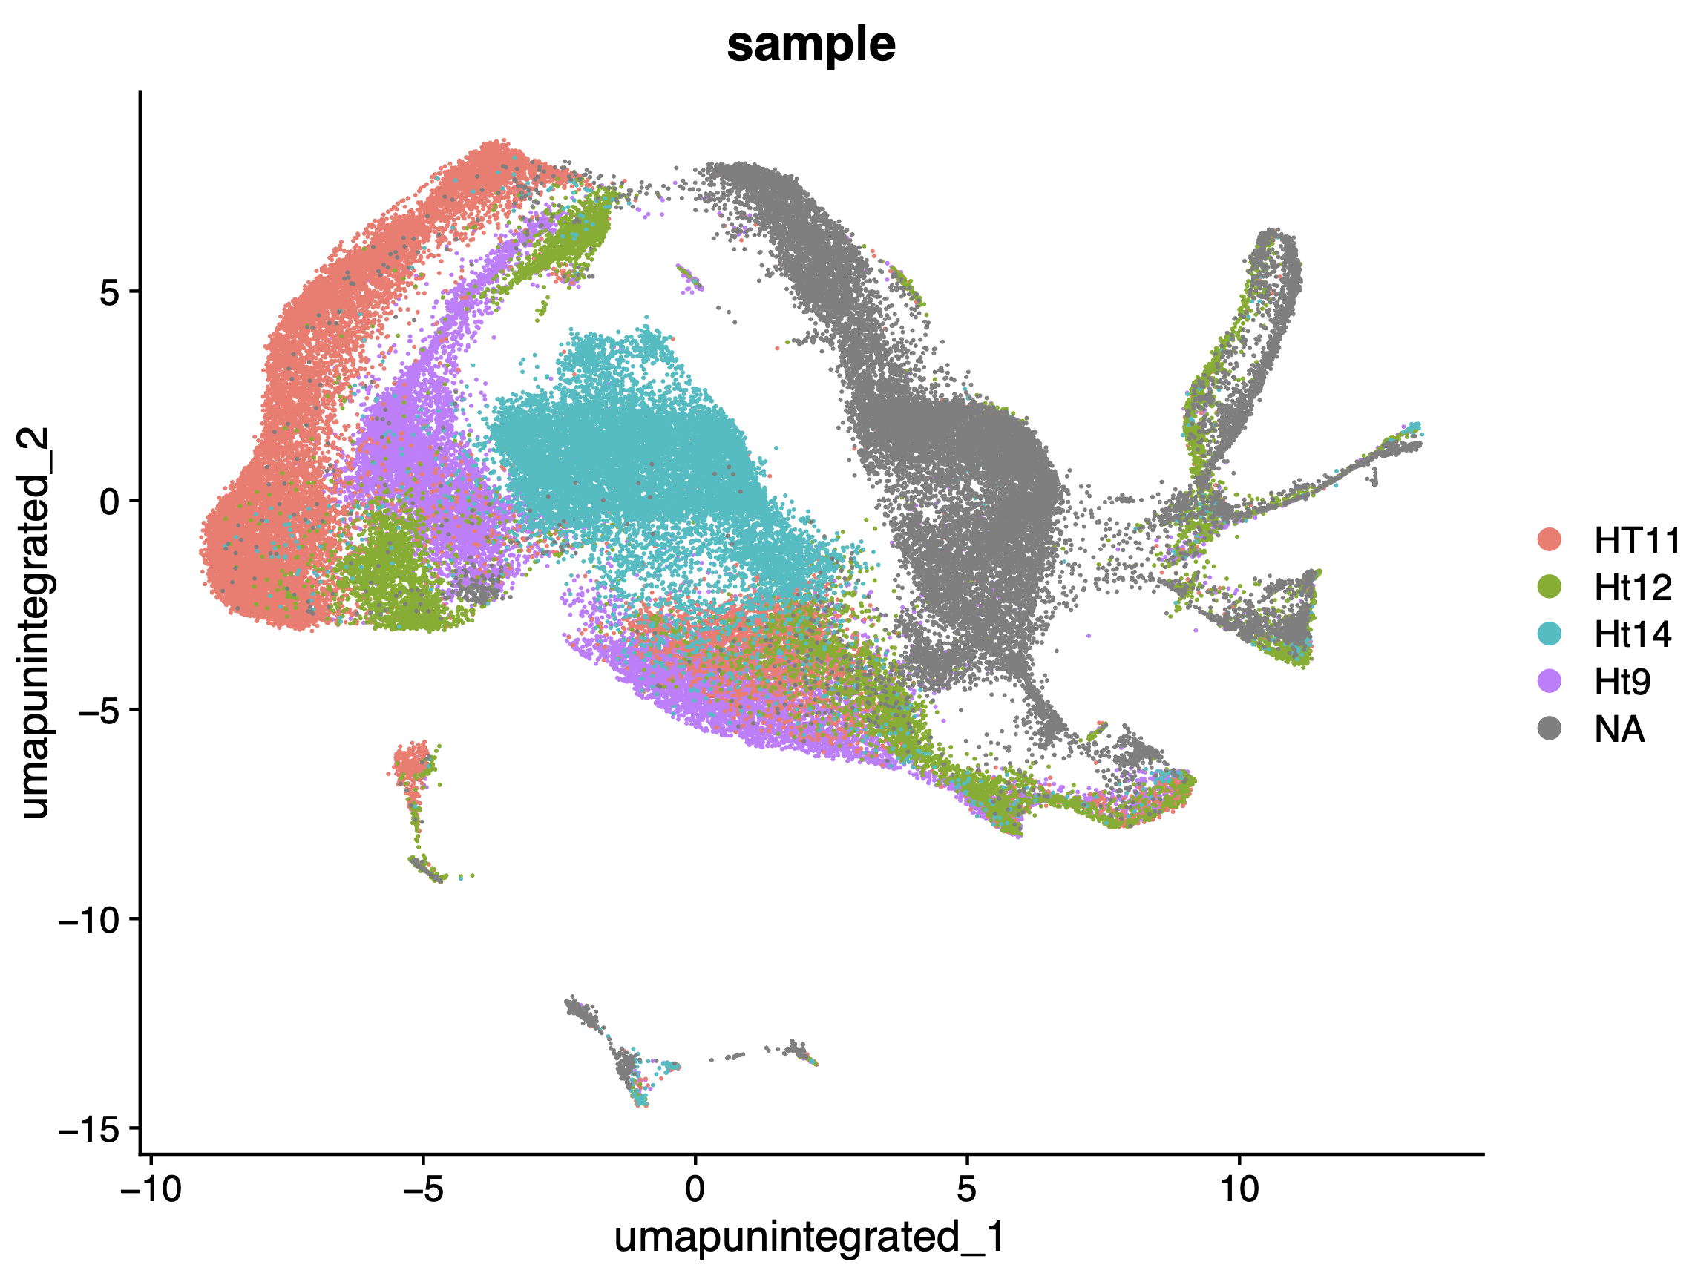
240205_1_merged_7_samples_pre-integrate_group_by_parse

Slide 2
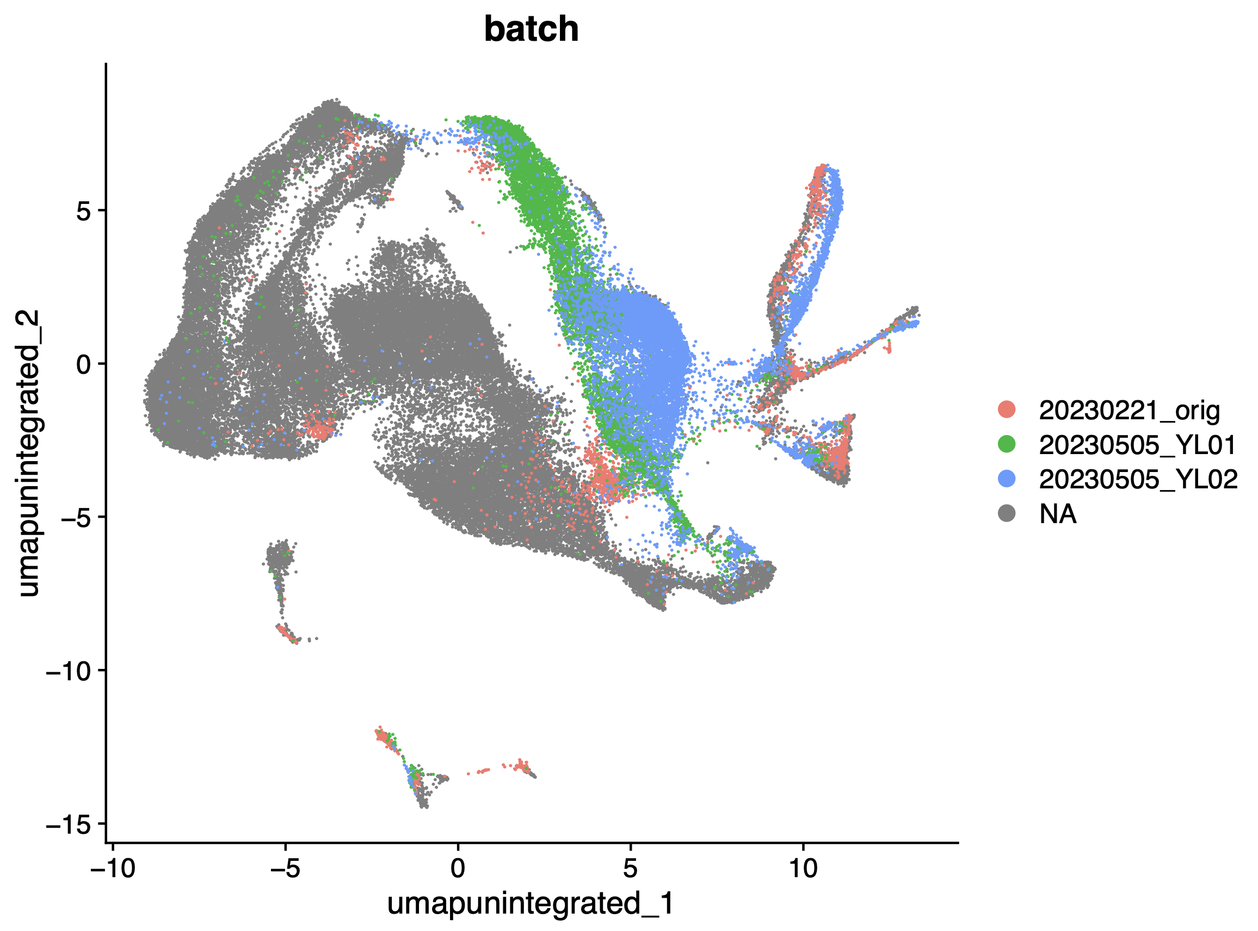
240205_2_merged_7_samples_pre-integrate_group_by_multiome

Slide 3
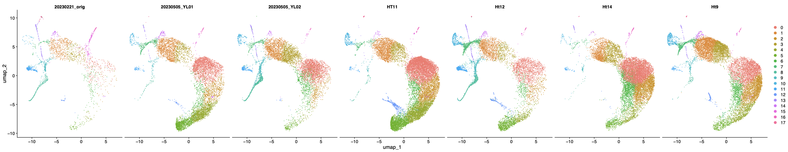
240205_3_integrated_7_samples-split_by_samples

Slide 4
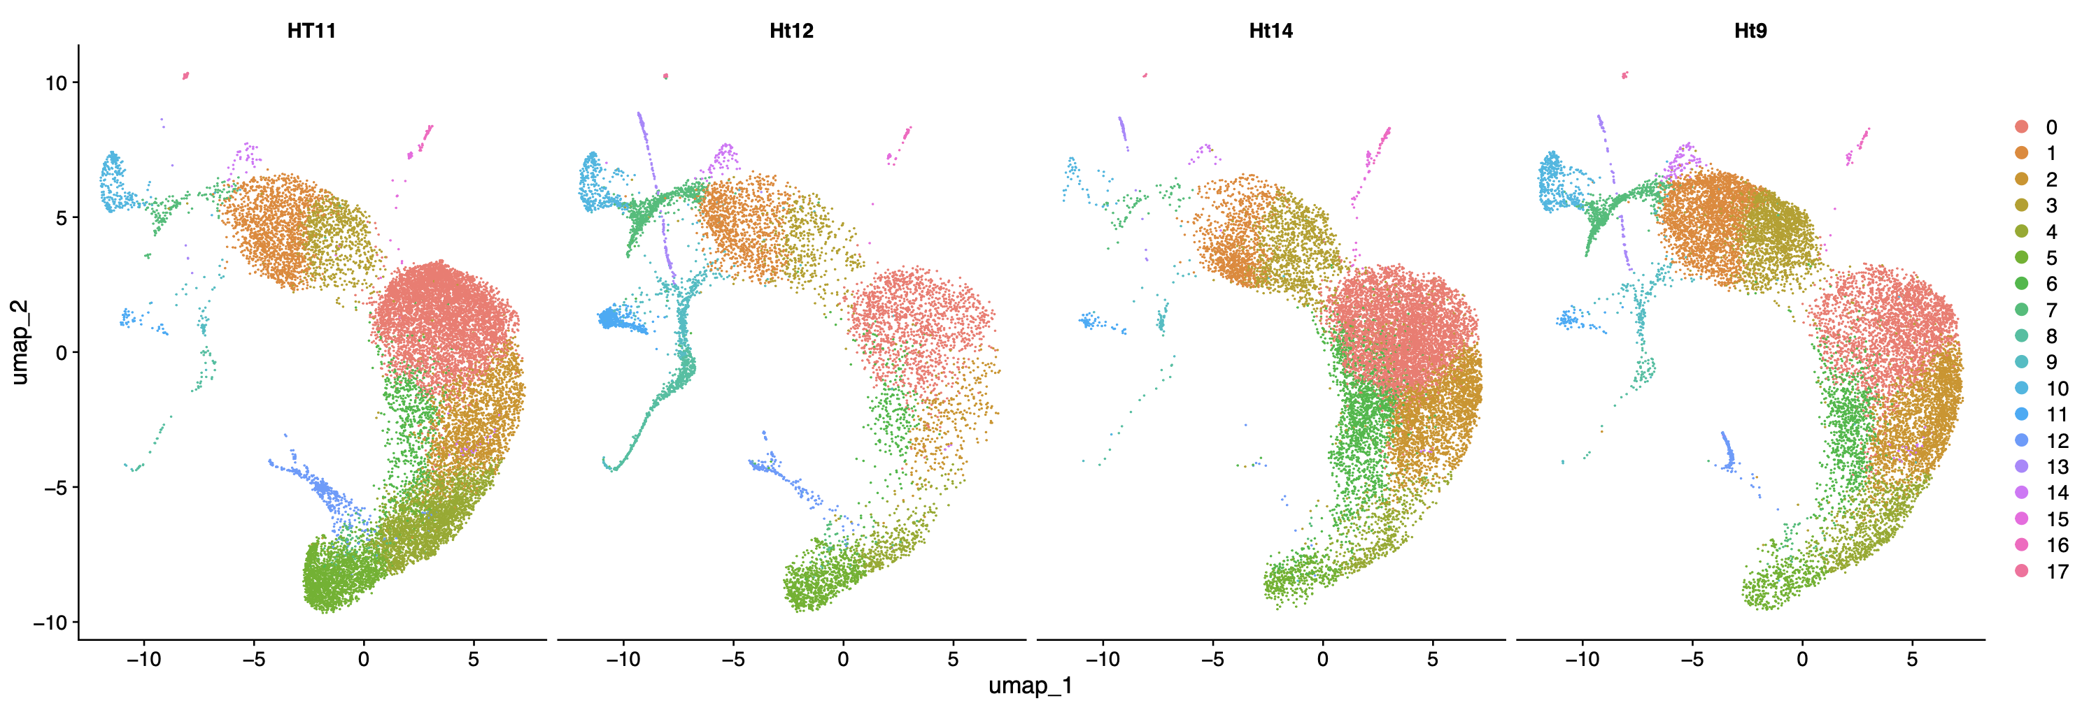
240205_4_integrated_7_samples-split_by_parse_samples

Slide 5
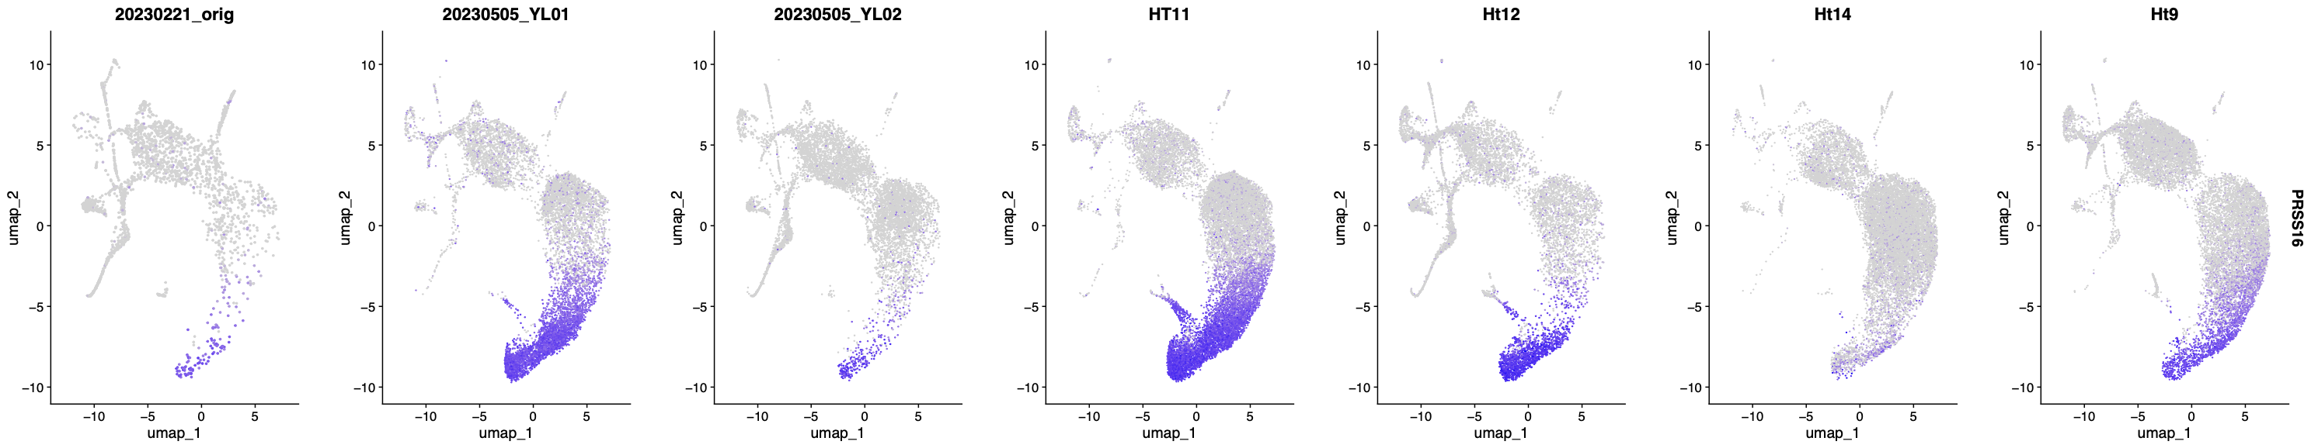
240205_7_integrated_7_samples-PRSS16

Slide 6
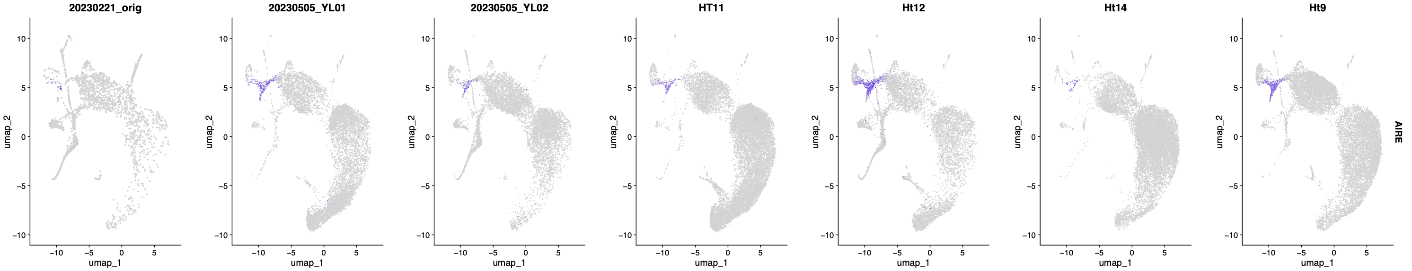
240205_8_integrated_7_samples-AIRE

Slide 7
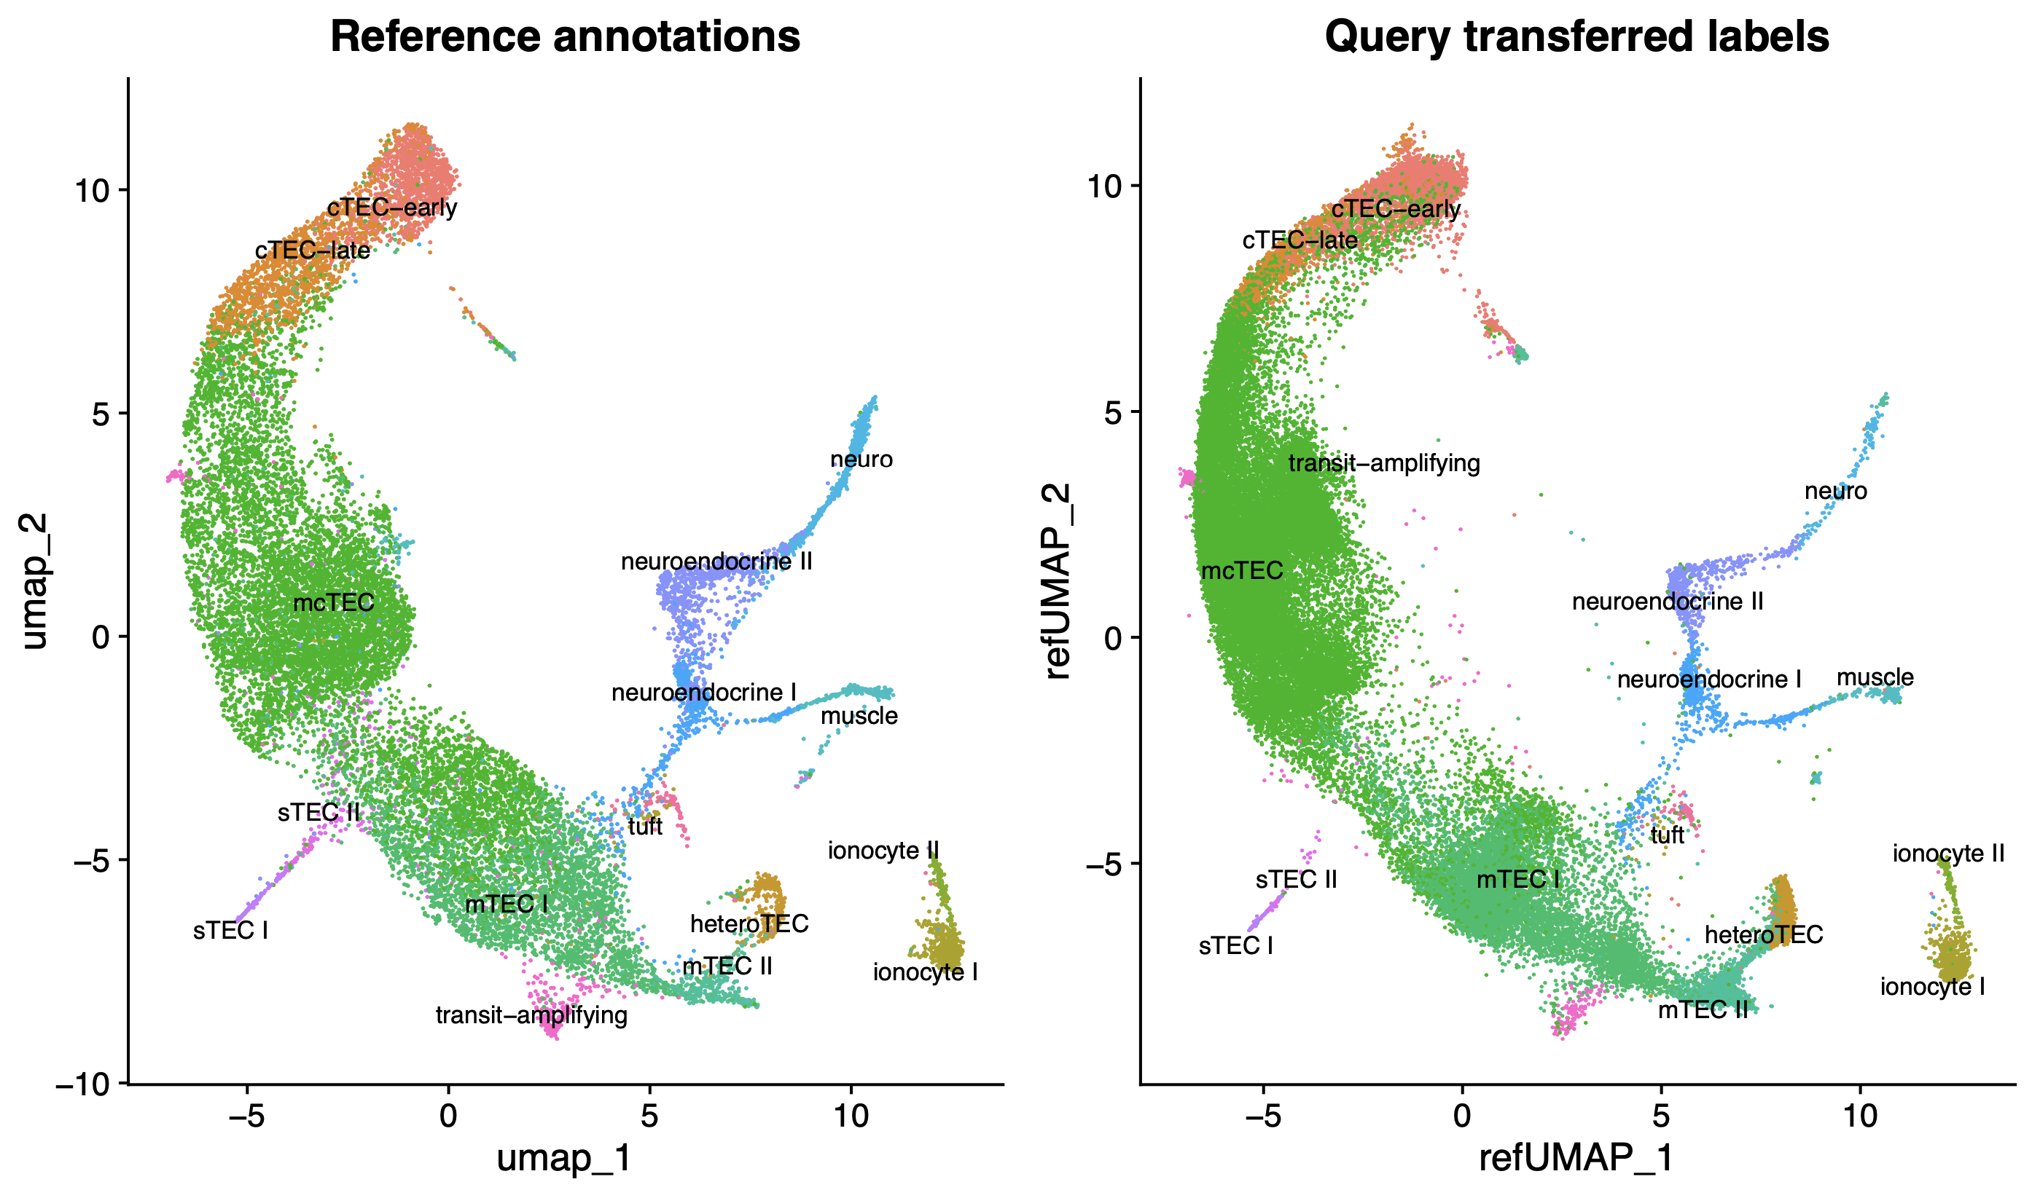
240205_11_tranfer_label_split_by_parse_multiome

Slide 8
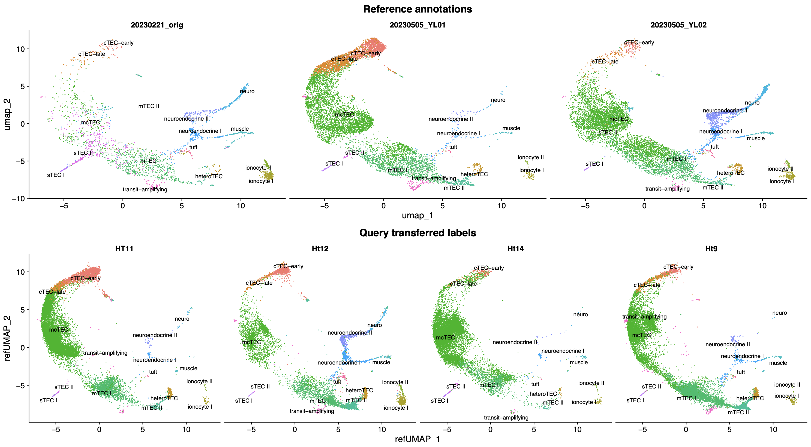
240205_12_tranfer_label_split_by_samples

Slide 9
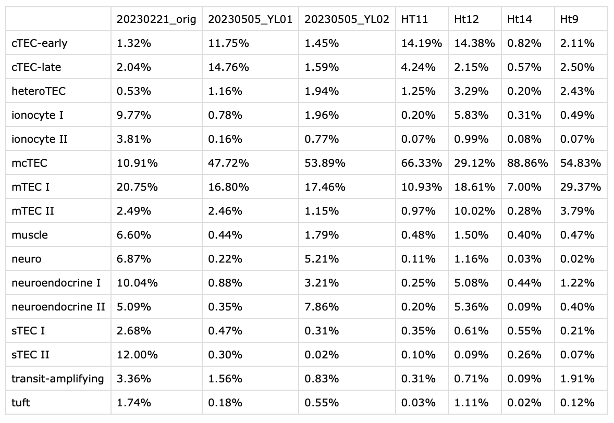
240205_tec_ref_and_query

Slide 10
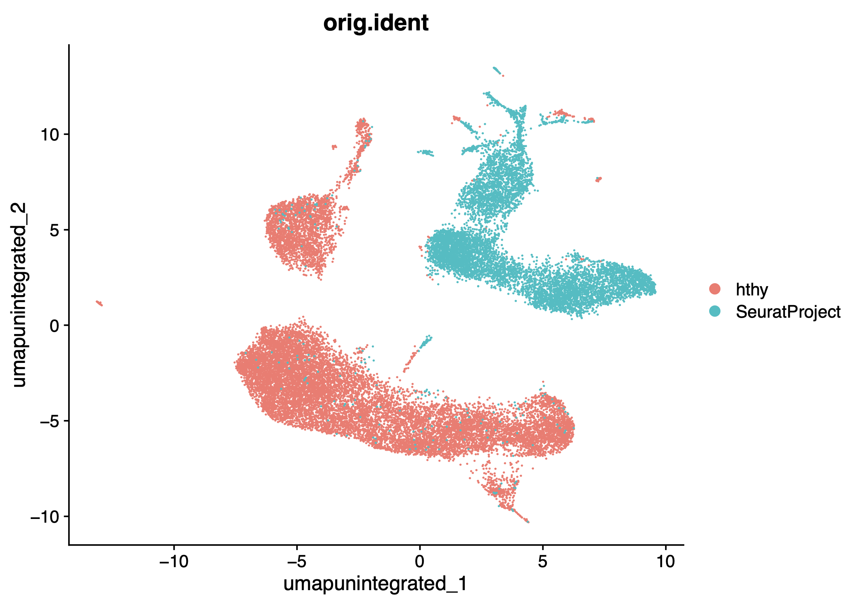
240205_9_ht11_only-pre_integrate-group_by_orig_ident

Slide 11
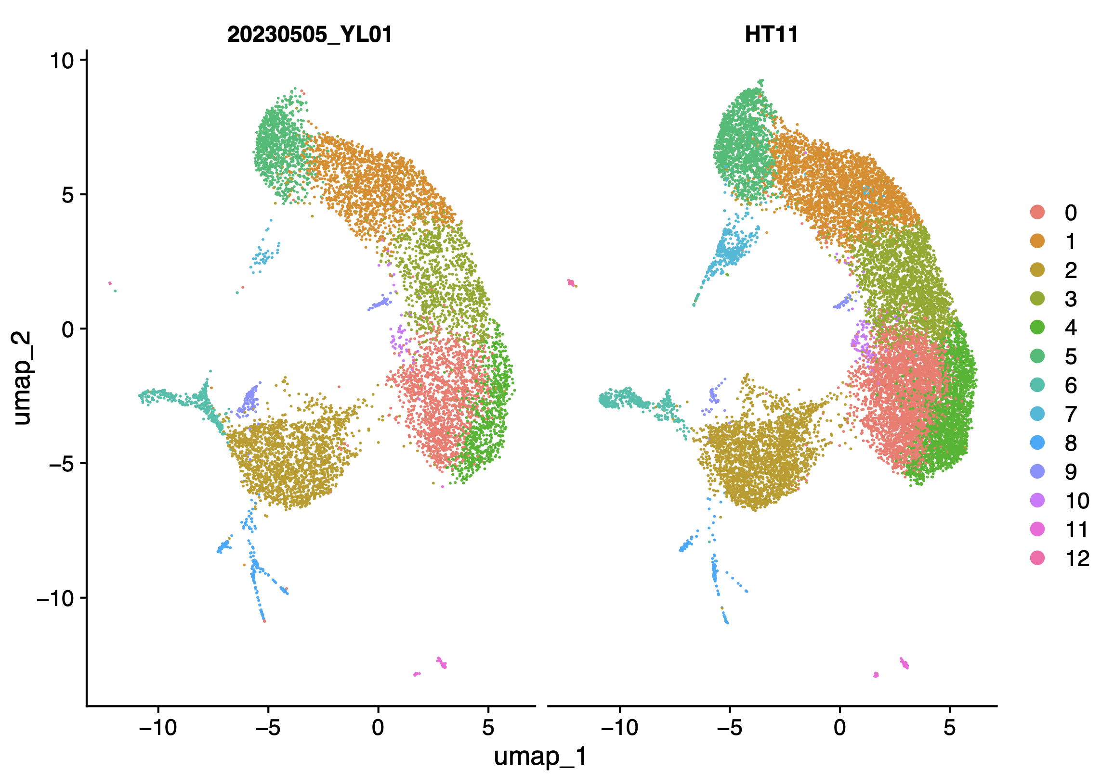
240205_10_ht11_only-integrated-split_by_parse_multiome

Slide 12
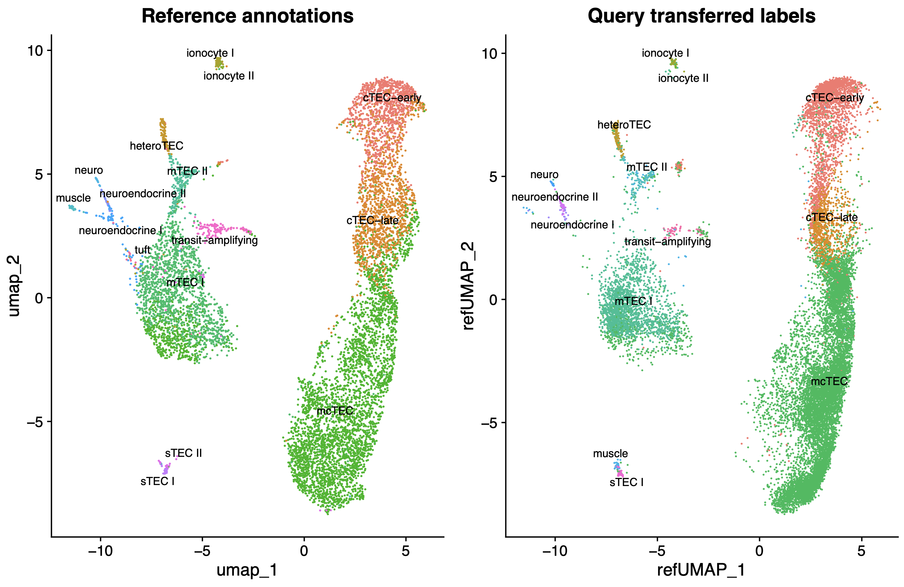
240205_ht11_label_transfer_group_by_orig_ident

Slide 13
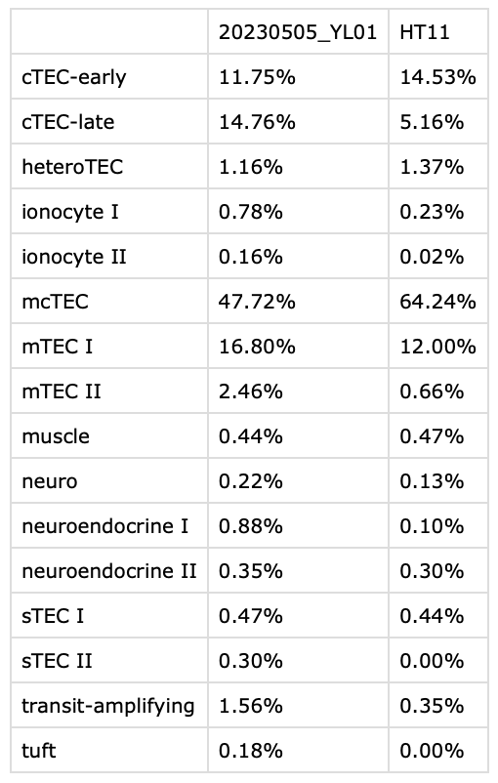
240205_ht11_ref_and_query

